Slide 1
Digital Portfolio
STUDENT NAME:
REGISTER NO AND NMID:
DEPARTMENT:
COLLEGE: COLLEGE/ UNIVERSITY
Eshwaran.D
F
24133021802521011
Computer science
Dr.rks arts &
Science college/annamalai University

Slide 2
PROJECT TITLE
1.Digitala portfolio
2.nanmudhalvan

Slide 3


AGENDA
Problem Statement
Project Overview
End Users
Tools and Technologies
Portfolio design and Layout
Features and Functionality
Results and Screenshots
Conclusion
Github Link
3/21/2024 Annual Review

Slide 4

PROBLEM STATEMENT
In today's era traditional resume are not enough to showcase skills and projects effectively. Many students and professional lack a structured online presence to highlight their work.Digital portfolio provides and interactive

Slide 5

PROJECT OVERVIEW
Developed a personal portfolio website.as part of Naan mudhalvan initiative
2.The portfolio includes sections such as about me to showcase skills and projects

Slide 6

WHO ARE THE END USERS?
Student
Students – Use it for academic projects, resumes, and presentations to showcase their skills.
Job Seekers – Share with recruiters and hiring managers to increase chances of getting hired.
Freelancers – Display previous work, portfolios, and services to attract new clients.
Professionals – Highlight experience, achievements, and career growth to build credibility.

Slide 7
TOOLS AND TECHNIQUES
HTML → Structure (pages, sections).
CSS → Styling (colors, layouts, responsiveness).
JavaScript → Interactivity (navigation menu, animations, form validation).
Code Editors → VS Code, CODEPEN
Hosting Platform → GitHub Pages

Slide 8
POTFOLIO DESIGN AND LAYOUT
1.About me : I am D. Eshwaran and I studying b.sc computer science department and I completed python programming language is currently working and html.
2.Projects:Naan mudhalvan projects
3.Contact: eshwerdurai@gmail.com
4.Skills:Listening
‹#›

Slide 9
FEATURES AND FUNCTIONALITY
•Navigation bar with smooth scrolling
•Project showcase with image of Naan mudhalvan

Slide 10
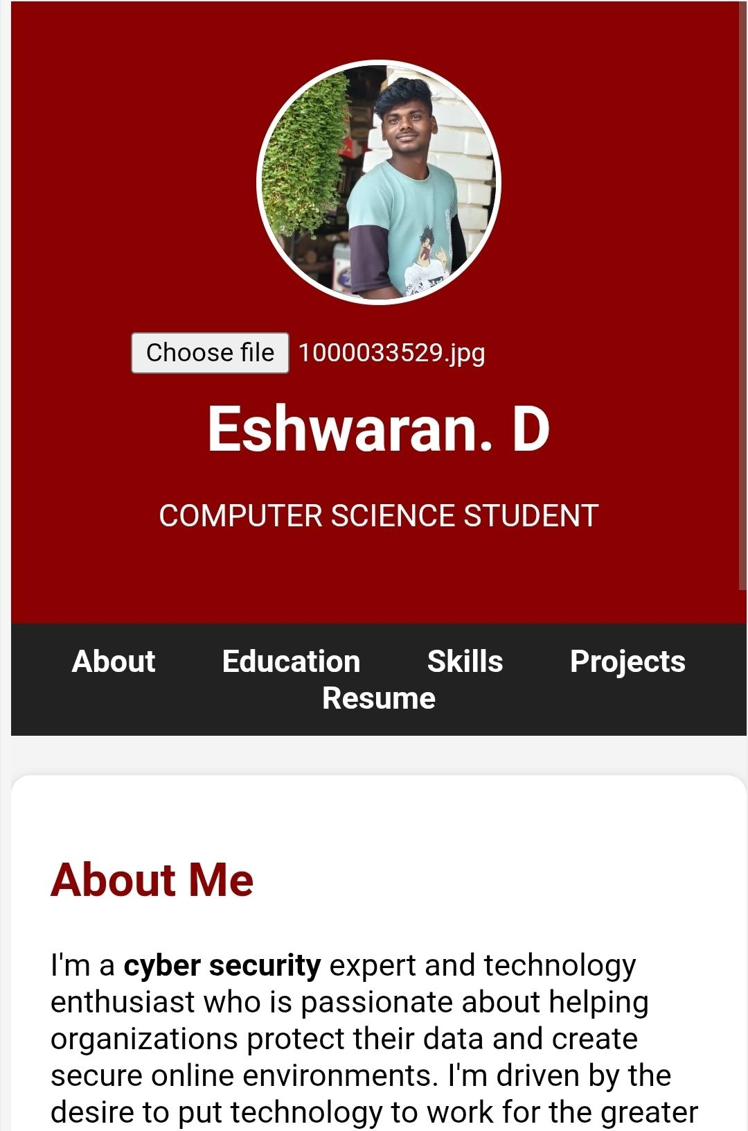
RESULTS AND SCREENSHOTS
3/21/2024 Annual Review
‹#›

Slide 11
CONCLUSION
Our project has demonstrated the practical applications of JavaScript in solving real-world problems and creating dynamic, interactive solutions.
We successfully highlighted the key features, design, and implementation process that showcase its effectiveness.
In summary, the project not only improved our technical knowledge and skills but also provided a clear pathway to building efficient web solutions.
Most importantly, it contributes positively to society by enhancing accessibility, simplifying user interaction, and encouraging the adoption of technology for everyday needs.
‹#›

